Slide 1
INTRODUCTION TO COMPUTING
Course Code: CCINCOM/L
Markov Decision Processes (MDP)
Elizer Ponio Jr.
Faculty Member
Department of Computer Science
College of Computing and Information Technologies (CCIT)
National University
Joseph Marvin R. Imperial
REINFORCEMENT LEARNING
NU College of Computing and Information Technologies
Course Code: CCRNFLRL

Slide 2
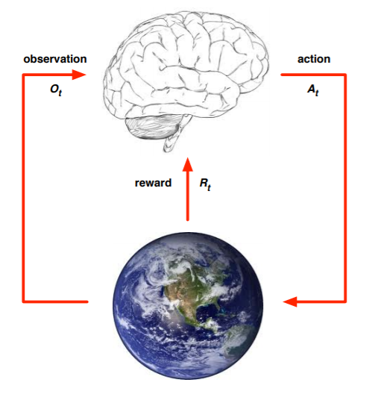

The Agent and the Environment
INTRODUCTION TO COMPUTING
Course Code: CCINCOM/L
At each timestep $t$, the agent:
• Performs an action $at$
• Receives observation $o_{t}$
• Receives reward $rt$
The environment:
• Receives action $at$
• Emits new observation $o_{t+1}$
• Emits reward for the agent $rt+1$
Joseph Marvin R. Imperial
REINFORCEMENT LEARNING
NU College of Computing and Information Technologies
Course Code: CCRNFLRL

Slide 3
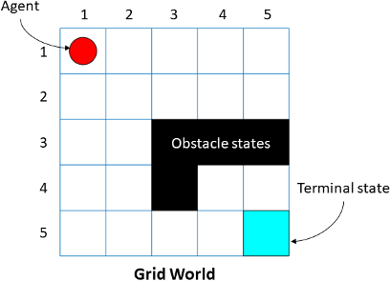
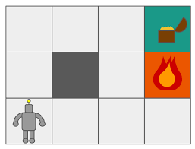
The Agent and the Environment
INTRODUCTION TO COMPUTING
Course Code: CCINCOM/L
Joseph Marvin R. Imperial
REINFORCEMENT LEARNING
NU College of Computing and Information Technologies
Course Code: CCRNFLRL

Slide 4
Markov Decision Processes (MDPs)
INTRODUCTION TO COMPUTING
Course Code: CCINCOM/L
Markov decision processes formally describe an environment for reinforcement learning.
Where the environment is fully observable.
Almost all RL problems can be formalized as MDPs:
Optimal control primarily deals with continuous MDPs.
Partially observable problems can be converted into MDPs.
Bandits are MDPs with one state.
Joseph Marvin R. Imperial
REINFORCEMENT LEARNING
NU College of Computing and Information Technologies
Course Code: CCRNFLRL

Slide 5
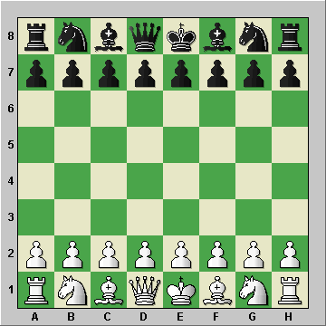

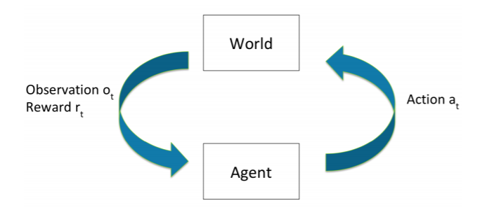

Fully Observable Environments
INTRODUCTION TO COMPUTING
Course Code: CCINCOM/L
Perfect information. The agent directly observes environment state.
Environment and world state $st = ot$
Formally, this is a Markov decision process (MDP).
Joseph Marvin R. Imperial
REINFORCEMENT LEARNING
NU College of Computing and Information Technologies
Course Code: CCRNFLRL

Slide 6
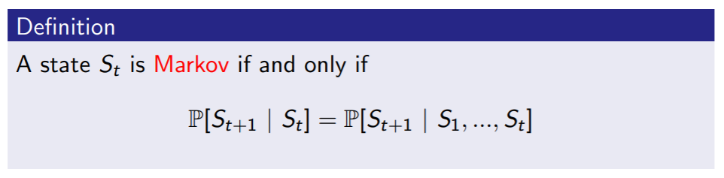
Markov Decision Processes (MDPs)
INTRODUCTION TO COMPUTING
Course Code: CCINCOM/L
“The future is independent of the past given the present.”
Once the state is known, the history may be thrown away because our current state already captures the information of the past states.
The (current) state is a sufficient statistic of the future.
Joseph Marvin R. Imperial
REINFORCEMENT LEARNING
NU College of Computing and Information Technologies
Course Code: CCRNFLRL

Slide 7
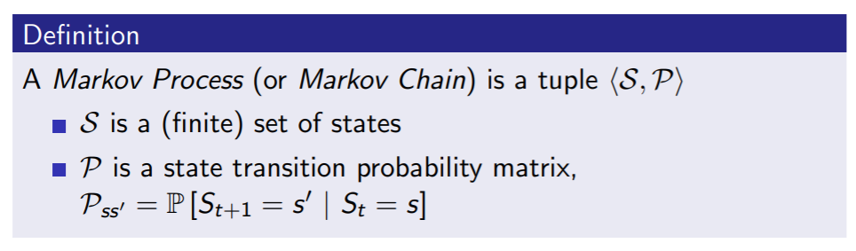

Markov Processes
INTRODUCTION TO COMPUTING
Course Code: CCINCOM/L
A Markov process is a random process, i.e. a sequence of random states $S1, S2$, ... with the Markov property.
Joseph Marvin R. Imperial
REINFORCEMENT LEARNING
NU College of Computing and Information Technologies
Course Code: CCRNFLRL

Slide 8

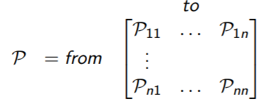
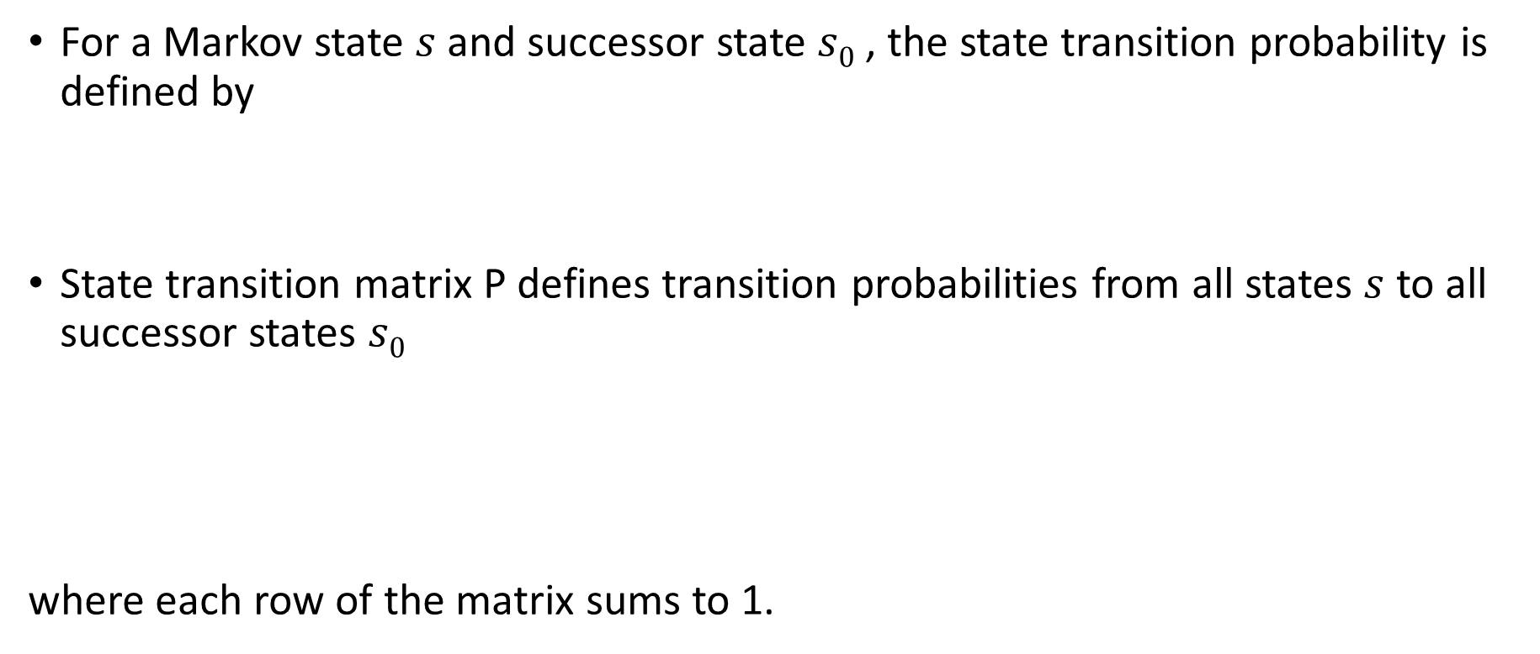
State Transition Matrix
INTRODUCTION TO COMPUTING
Course Code: CCINCOM/L
For a Markov state $s$ and successor state $s0$ , the state transition probability is defined by
State transition matrix P defines transition probabilities from all states $s$ to all successor states $s0$
where each row of the matrix sums to 1.
Joseph Marvin R. Imperial
REINFORCEMENT LEARNING
NU College of Computing and Information Technologies
Course Code: CCRNFLRL

Slide 9
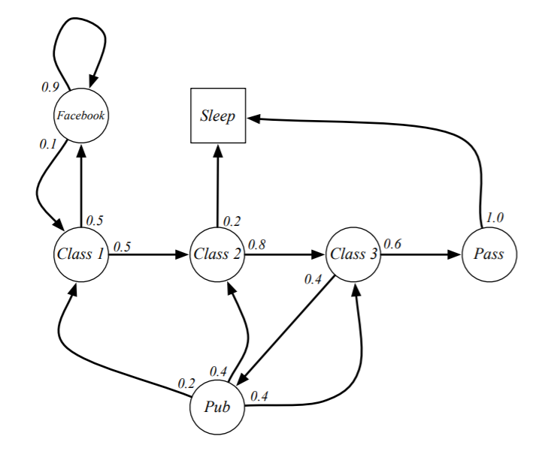
Student Markov Chain
INTRODUCTION TO COMPUTING
Course Code: CCINCOM/L
Joseph Marvin R. Imperial
REINFORCEMENT LEARNING
NU College of Computing and Information Technologies
Course Code: CCRNFLRL

Slide 10
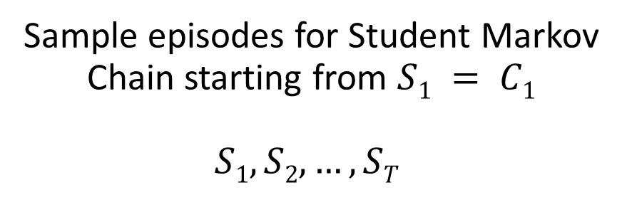
Student Markov Chain
INTRODUCTION TO COMPUTING
Course Code: CCINCOM/L
Sample episodes for Student Markov Chain starting from $S1 = C1$
$$S1, S2, …, ST$$
C1 C2 C3 Pass Sleep
C1 FB FB C1 C2 Sleep
C1 C2 C3 Pub C2 C3 Pass Sleep
C1 FB FB C1 C2 C3 Pub C1 FB FB FB C1 C2 C3 Pub C2 Sleep
Joseph Marvin R. Imperial
REINFORCEMENT LEARNING
NU College of Computing and Information Technologies
Course Code: CCRNFLRL

Slide 11
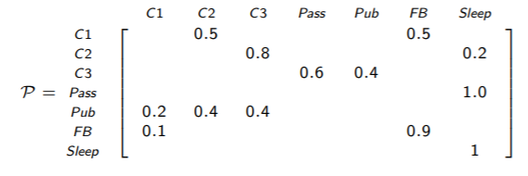
Student Markov Chain
INTRODUCTION TO COMPUTING
Course Code: CCINCOM/L
Joseph Marvin R. Imperial
REINFORCEMENT LEARNING
NU College of Computing and Information Technologies
Course Code: CCRNFLRL

Slide 12
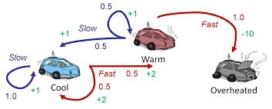
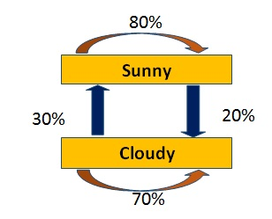
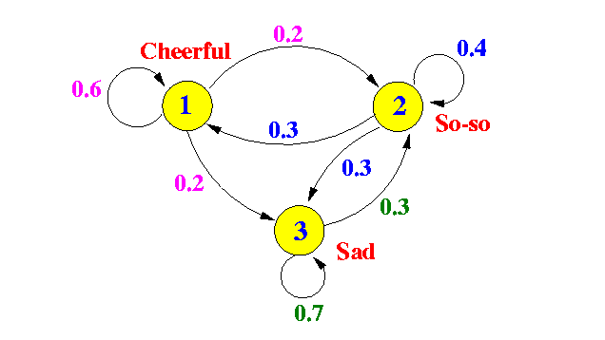
Examples
INTRODUCTION TO COMPUTING
Course Code: CCINCOM/L
Joseph Marvin R. Imperial
REINFORCEMENT LEARNING
NU College of Computing and Information Technologies
Course Code: CCRNFLRL

Slide 13
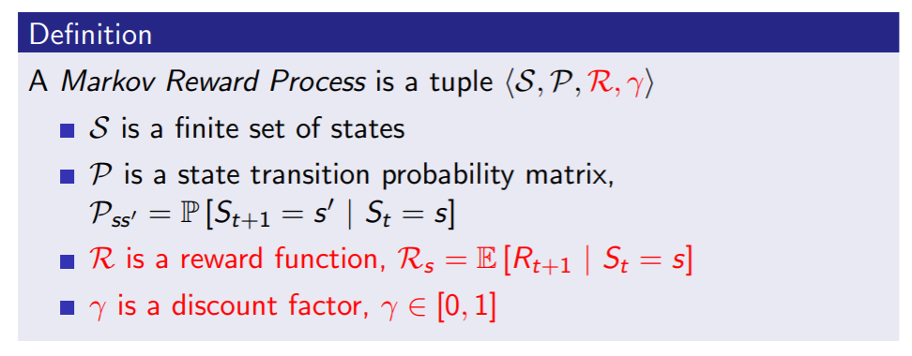
Markov Reward Process (MRPs)
INTRODUCTION TO COMPUTING
Course Code: CCINCOM/L
A Markov reward process is a Markov chain with values.
Joseph Marvin R. Imperial
REINFORCEMENT LEARNING
NU College of Computing and Information Technologies
Course Code: CCRNFLRL

Slide 14
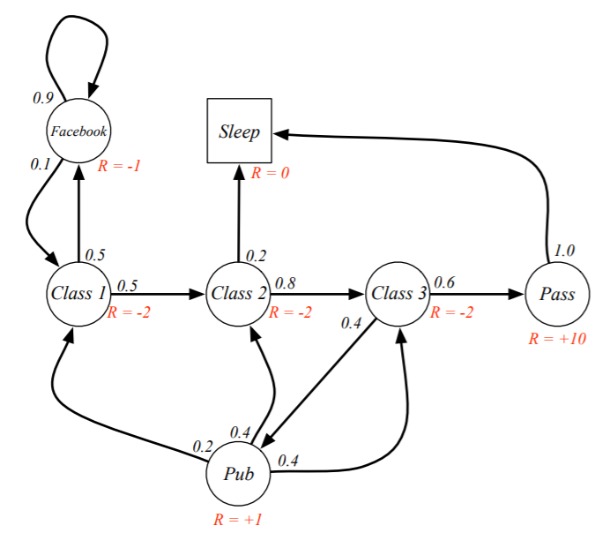
Markov Reward Process (MRPs)
INTRODUCTION TO COMPUTING
Course Code: CCINCOM/L
Joseph Marvin R. Imperial
REINFORCEMENT LEARNING
NU College of Computing and Information Technologies
Course Code: CCRNFLRL

Slide 15
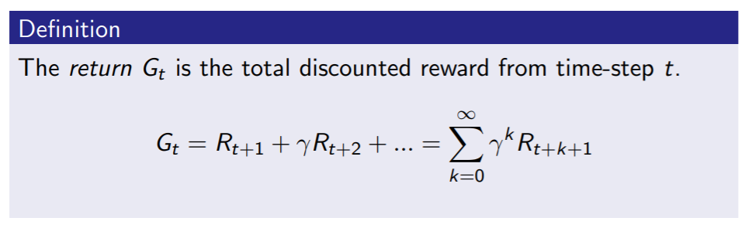

Return
INTRODUCTION TO COMPUTING
Course Code: CCINCOM/L
The discount $γ ∈ [0, 1]$is the present value of future rewards.
The value of receiving reward $R$ after $k + 1$time-steps is $γkR$.
This values immediate reward above delayed reward.
$γ$ close to 0 leads to ”myopic” evaluation.
$γ$ close to 1 leads to ”far-sighted” evaluation.
Review in Probability, Intro to RL Concepts
Joseph Marvin R. Imperial
REINFORCEMENT LEARNING
NU College of Computing and Information Technologies
Course Code: CCRNFLRL

Slide 16
Why discount the reward?
INTRODUCTION TO COMPUTING
Course Code: CCINCOM/L
Uncertainty about the future may not be fully represented.
Animal/human behavior shows preference for immediate reward.
Joseph Marvin R. Imperial
REINFORCEMENT LEARNING
NU College of Computing and Information Technologies
Course Code: CCRNFLRL

Slide 17
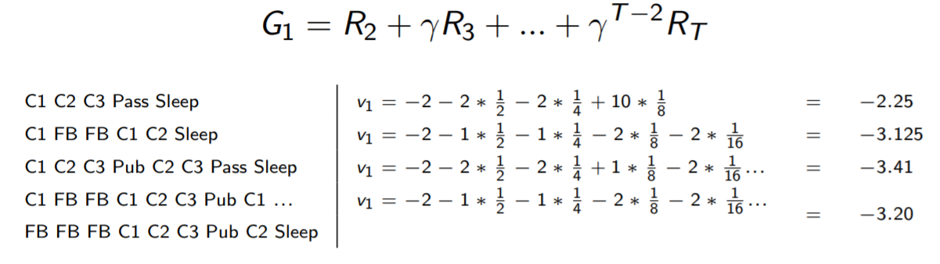

Student MRP Returns
INTRODUCTION TO COMPUTING
Course Code: CCINCOM/L
Sample returns for Student MRP:
Starting from $S1 = C1$with $γ = ½$
Joseph Marvin R. Imperial
REINFORCEMENT LEARNING
NU College of Computing and Information Technologies
Course Code: CCRNFLRL

Slide 18
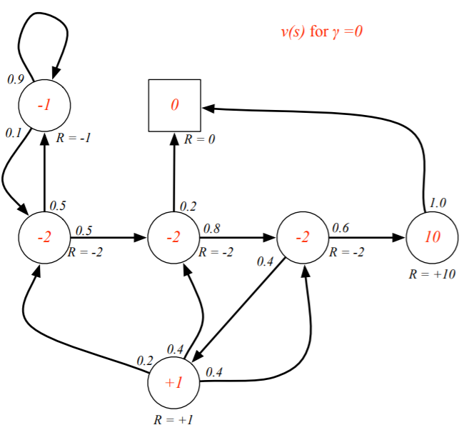
State-Value Function for Student MRP
INTRODUCTION TO COMPUTING
Course Code: CCINCOM/L
Joseph Marvin R. Imperial
REINFORCEMENT LEARNING
NU College of Computing and Information Technologies
Course Code: CCRNFLRL

Slide 19
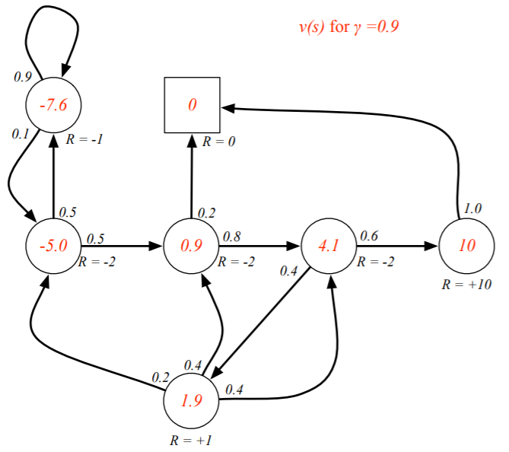
State-Value Function for Student MRP
INTRODUCTION TO COMPUTING
Course Code: CCINCOM/L
Joseph Marvin R. Imperial
REINFORCEMENT LEARNING
NU College of Computing and Information Technologies
Course Code: CCRNFLRL

Slide 20
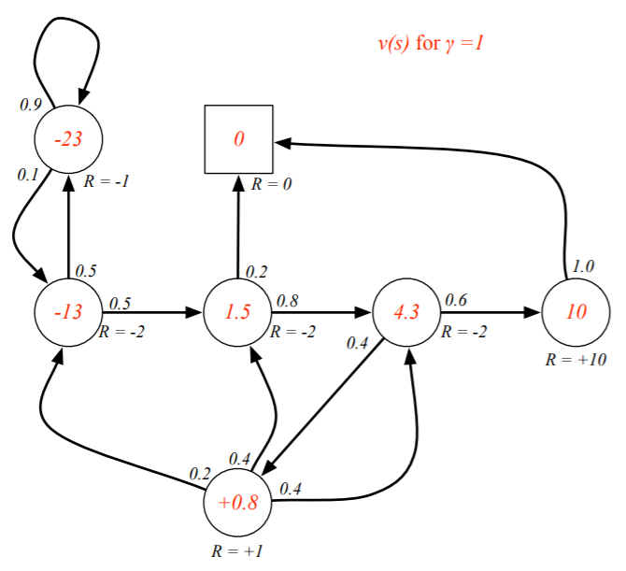
State-Value Function for Student MRP
INTRODUCTION TO COMPUTING
Course Code: CCINCOM/L
Joseph Marvin R. Imperial
REINFORCEMENT LEARNING
NU College of Computing and Information Technologies
Course Code: CCRNFLRL

Slide 21
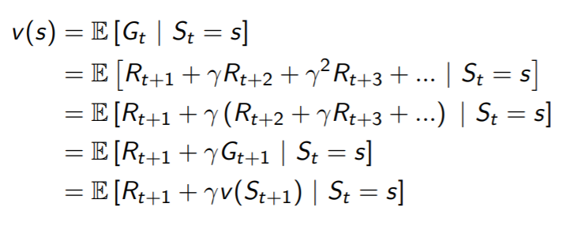

Bellman Equation for MRPs
INTRODUCTION TO COMPUTING
Course Code: CCINCOM/L
The value function can be decomposed into two parts:
immediate reward $R_{t+1}$
discounted value of successor state $γv(S_{t+1})$
Joseph Marvin R. Imperial
REINFORCEMENT LEARNING
NU College of Computing and Information Technologies
Course Code: CCRNFLRL

Slide 22
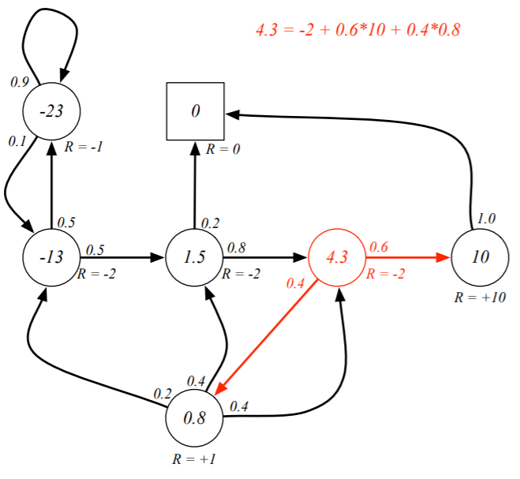
Bellman Equation for Student MRP
INTRODUCTION TO COMPUTING
Course Code: CCINCOM/L
Joseph Marvin R. Imperial
REINFORCEMENT LEARNING
NU College of Computing and Information Technologies
Course Code: CCRNFLRL

Slide 23
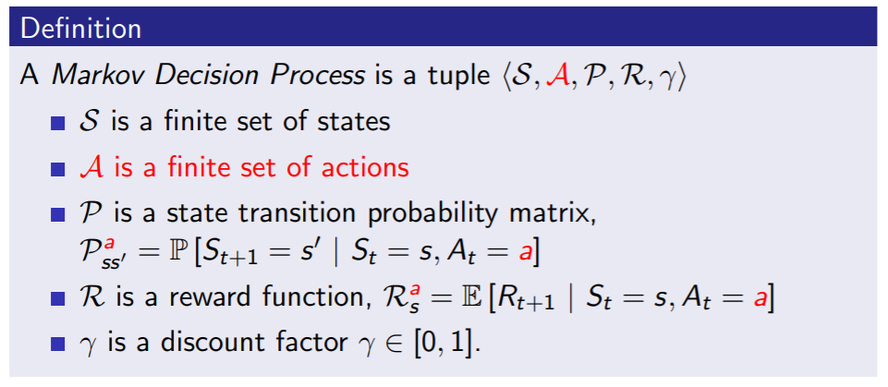
Markov Decision Processes (MDPs)
INTRODUCTION TO COMPUTING
Course Code: CCINCOM/L
A Markov decision process (MDP) is a Markov reward process with decisions. It is an environment in which all states are Markov.
Joseph Marvin R. Imperial
REINFORCEMENT LEARNING
NU College of Computing and Information Technologies
Course Code: CCRNFLRL

Slide 24
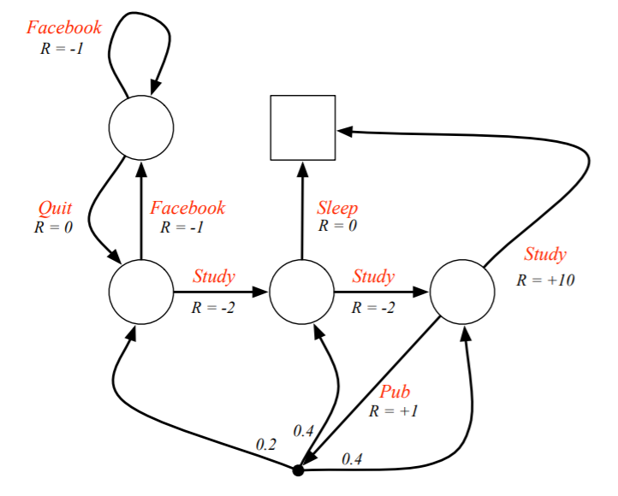
Student MDP
INTRODUCTION TO COMPUTING
Course Code: CCINCOM/L
Joseph Marvin R. Imperial
REINFORCEMENT LEARNING
NU College of Computing and Information Technologies
Course Code: CCRNFLRL

Slide 25
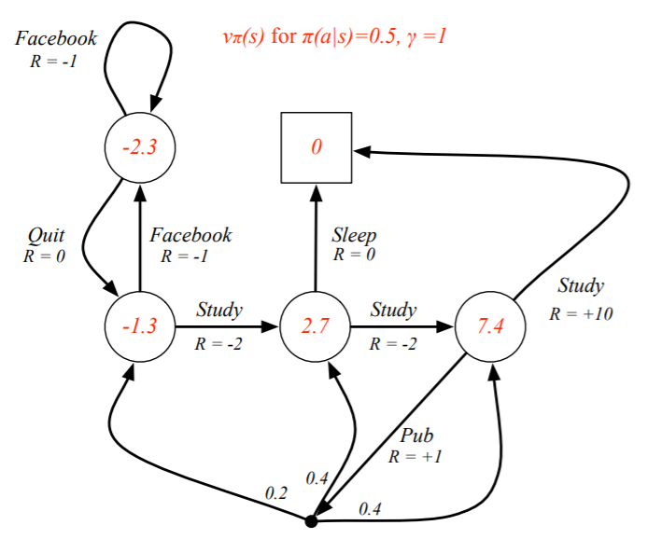
Student Value-Function MDP
INTRODUCTION TO COMPUTING
Course Code: CCINCOM/L
Joseph Marvin R. Imperial
REINFORCEMENT LEARNING
NU College of Computing and Information Technologies
Course Code: CCRNFLRL

Slide 26
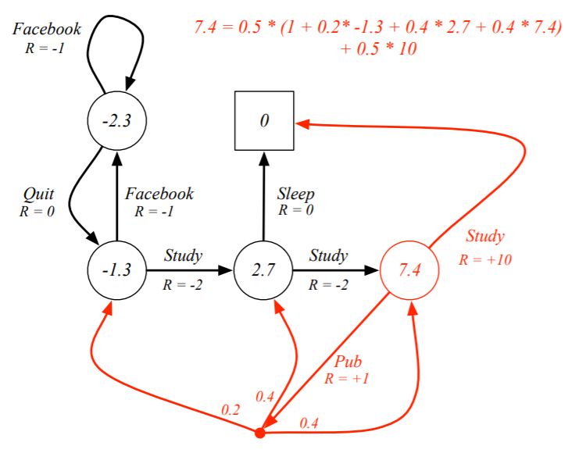
Bellman Expectation Equation in Student MDP
INTRODUCTION TO COMPUTING
Course Code: CCINCOM/L
Joseph Marvin R. Imperial
REINFORCEMENT LEARNING
NU College of Computing and Information Technologies
Course Code: CCRNFLRL

Slide 27
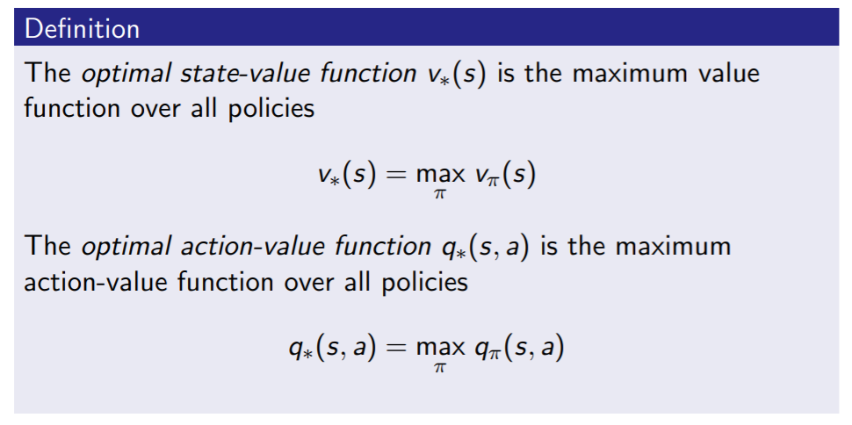
Optimal Value Function
INTRODUCTION TO COMPUTING
Course Code: CCINCOM/L
The optimal value function specifies the best possible performance in the MDP.
An MDP is “solved” when we know the optimal value.
Joseph Marvin R. Imperial
REINFORCEMENT LEARNING
NU College of Computing and Information Technologies
Course Code: CCRNFLRL

Slide 28
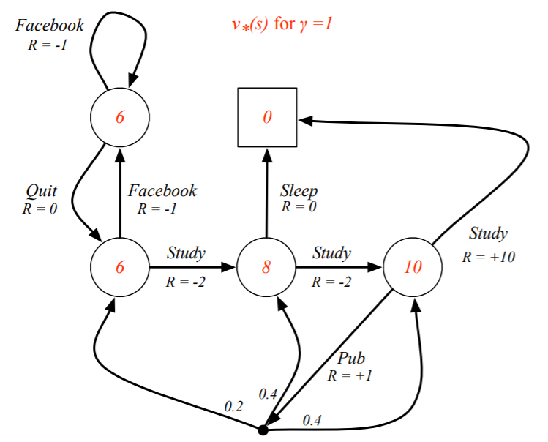
Optimal Value Function for Student MDP
INTRODUCTION TO COMPUTING
Course Code: CCINCOM/L
Joseph Marvin R. Imperial
REINFORCEMENT LEARNING
NU College of Computing and Information Technologies
Course Code: CCRNFLRL

Slide 29
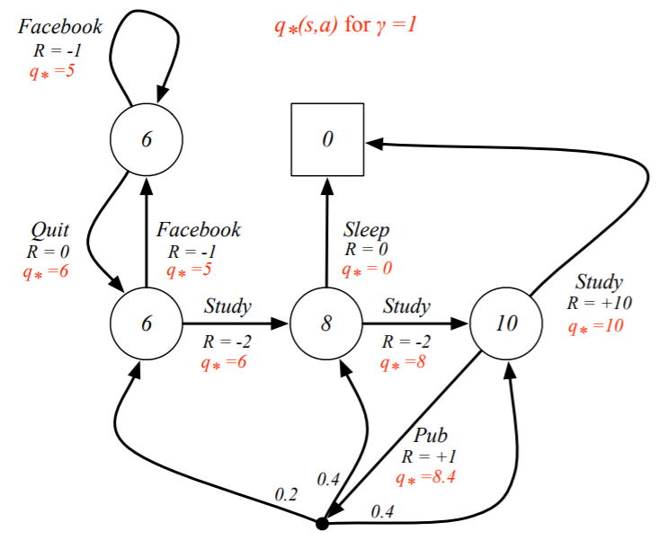
Optimal Action-Value Function for Student MDP
INTRODUCTION TO COMPUTING
Course Code: CCINCOM/L
Joseph Marvin R. Imperial
REINFORCEMENT LEARNING
NU College of Computing and Information Technologies
Course Code: CCRNFLRL

Slide 30
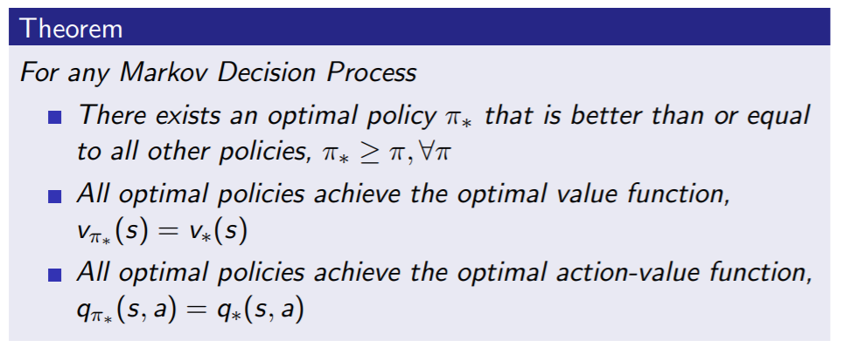
Optimal Policy
INTRODUCTION TO COMPUTING
Course Code: CCINCOM/L
Joseph Marvin R. Imperial
REINFORCEMENT LEARNING
NU College of Computing and Information Technologies
Course Code: CCRNFLRL

Slide 31
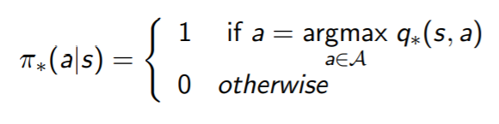
Finding an Optimal Policy
INTRODUCTION TO COMPUTING
Course Code: CCINCOM/L
An optimal policy can be found by maximizing over q∗(s, a)
There is always a deterministic optimal policy for any MDP.
If we know q∗(s, a), we immediately have the optimal policy.
Joseph Marvin R. Imperial
REINFORCEMENT LEARNING
NU College of Computing and Information Technologies
Course Code: CCRNFLRL

Slide 32
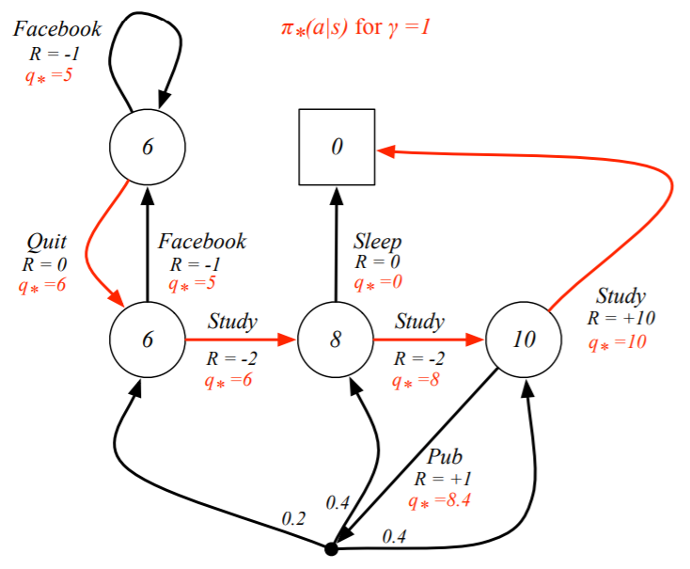
Optimal Policy for Student MDP
INTRODUCTION TO COMPUTING
Course Code: CCINCOM/L
Joseph Marvin R. Imperial
REINFORCEMENT LEARNING
NU College of Computing and Information Technologies
Course Code: CCRNFLRL

Slide 33
Programming Exercise: Gridworld
INTRODUCTION TO COMPUTING
Course Code: CCINCOM/L
Joseph Marvin R. Imperial
REINFORCEMENT LEARNING
NU College of Computing and Information Technologies
Course Code: CCRNFLRL

Slide 34
References
INTRODUCTION TO COMPUTING
Course Code: CCINCOM/L
Images are licensed with Creative Commons. Can use without citing.
Prof. Emma Brunskill’s slides (CS234RL). https://web.stanford.edu/class/cs234/slides/lecture1.pdf
David Silver’s slides. https://www.davidsilver.uk/wp-content/uploads/2020/03/intro_RL.pdf
Review in Probability, Intro to RL Concepts
Joseph Marvin R. Imperial
REINFORCEMENT LEARNING
NU College of Computing and Information Technologies
Course Code: CCRNFLRL

